Slide 1
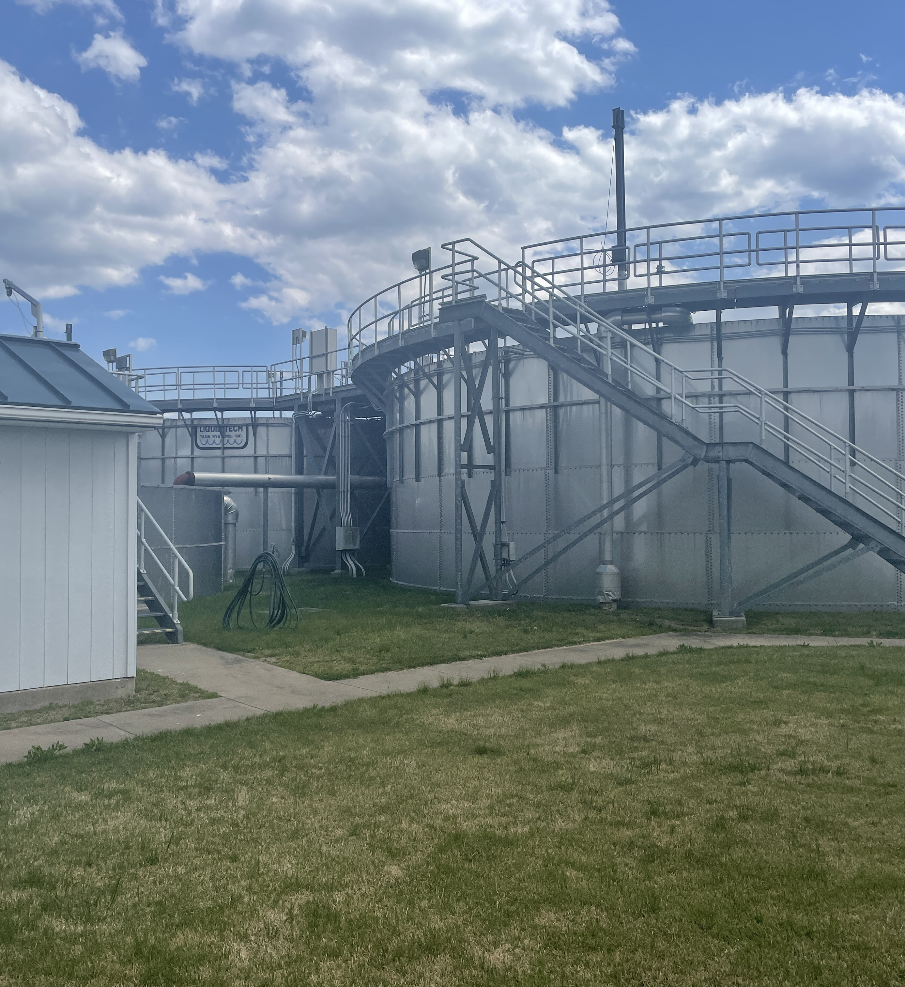
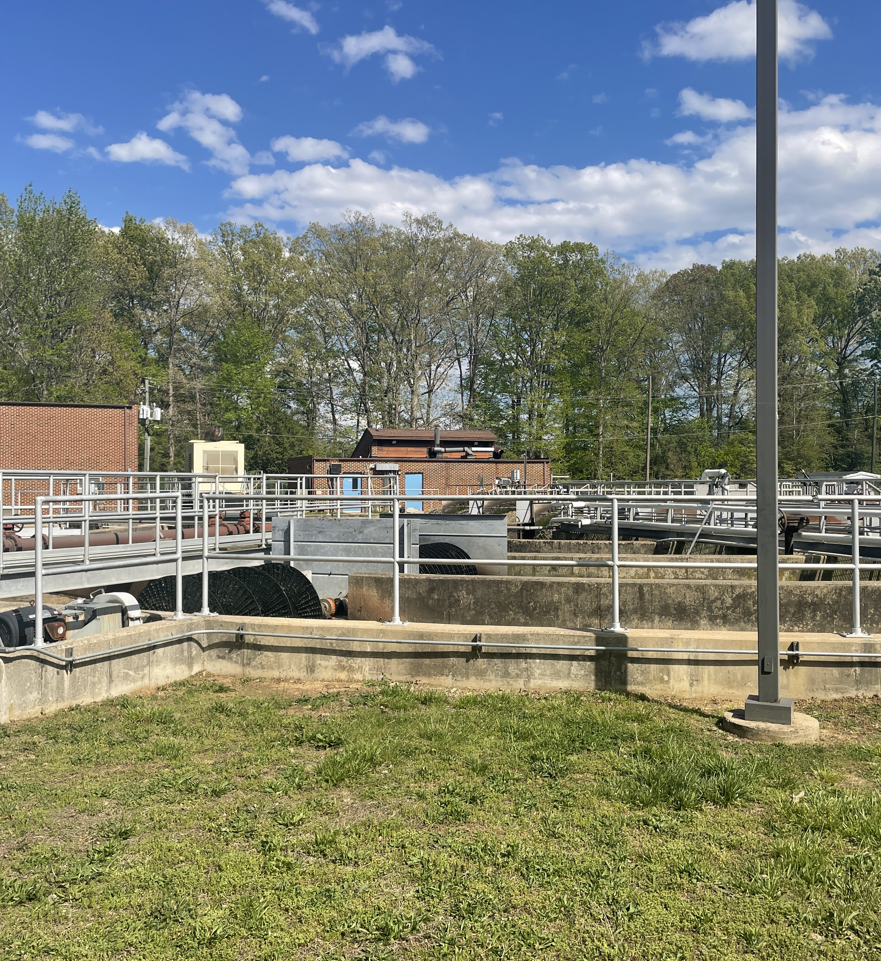

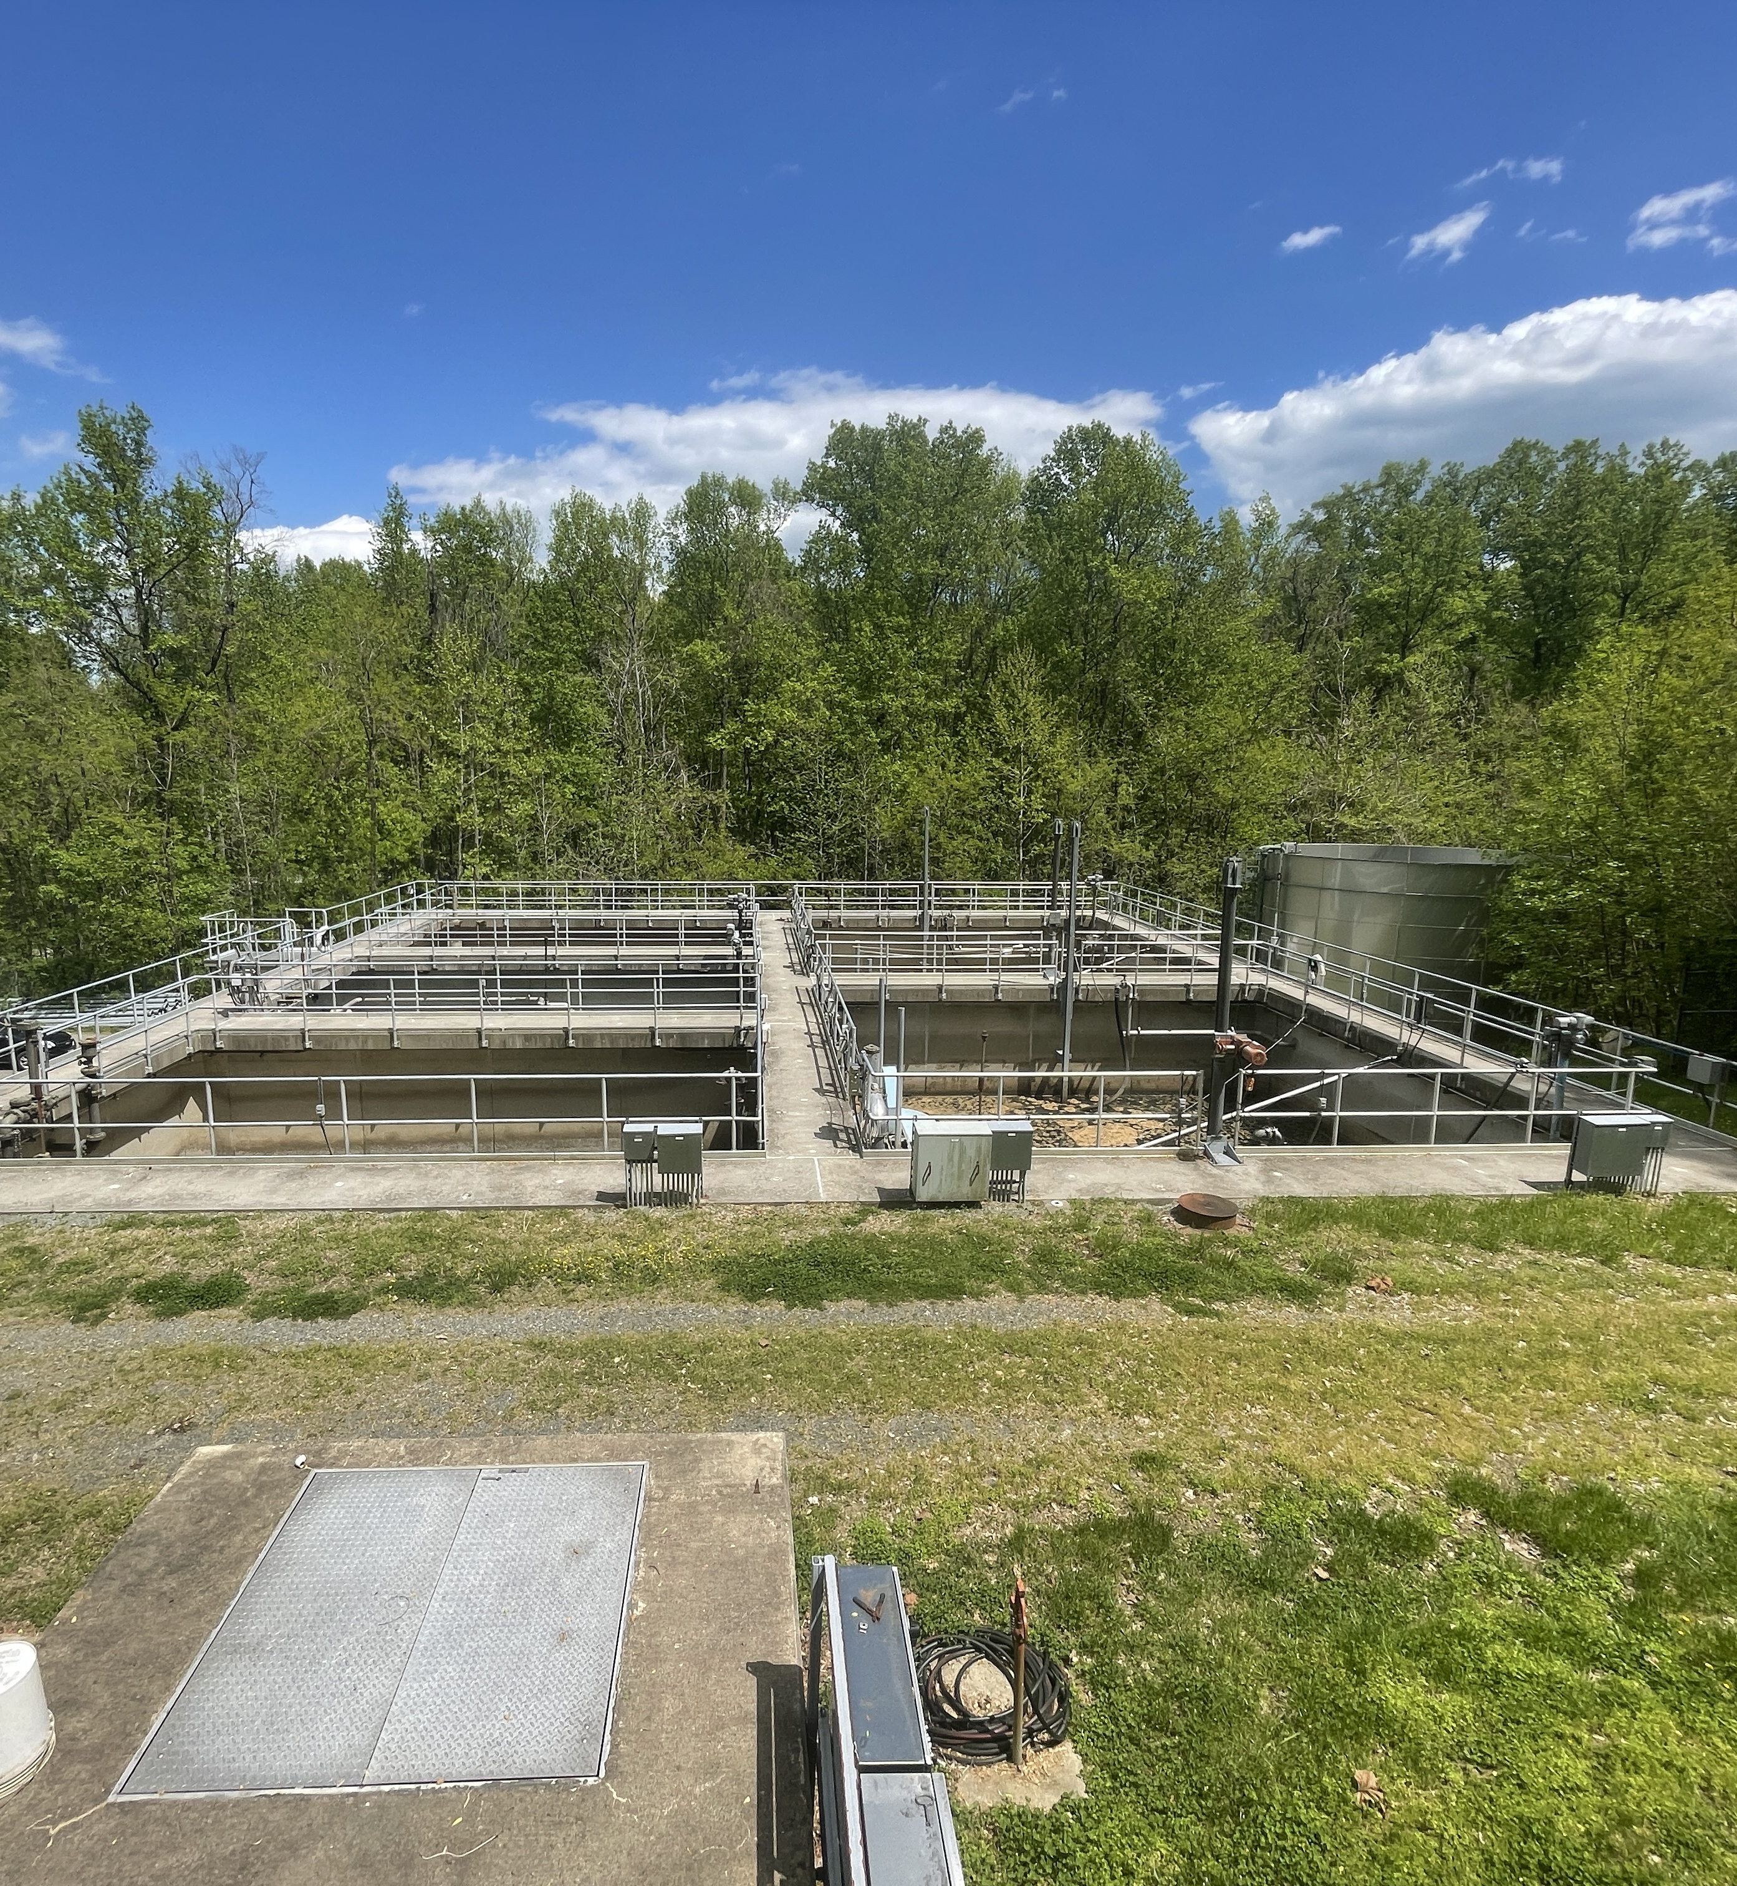

MARCH 2025
Monthly Operations Overview

Slide 2
Dahlgren WWTP
Influent pumps de-ragged due to a loss of performance with influent screen still being out of service.
Sludge transfer valves for Digester 3 & 4 replaced due to breakage
Supplemental carbon tank installed
IES brought an Aqua Aerobics representative on-site to assess the condition of the tertiary disc filter.
On-site meeting with Bowman Engineering to collaborate and discuss recommended changes.

Slide 3
Hopyard Farms WWTP
SBR Blower #1 replaced and diagnosed issues with Blower #2
Carter CAT performed preventative maintenance on the emergency generator and repaired an engine coolant leak.
Drain line for SBR#1 became clogged – KGCSA jetted/cleared line
Fairview Beach WWTP
Vegetation on both SBR decanters removed by KGM.

Slide 4
Purkins Corner WWTP
Treatment plant exceeded CBOD5, TSS, and TKN for the month of March:
Exceedances caused a large amount of grease entered the facility due to a significant grease back up that occurred within the collection system. IES pulled samples of the influent and found FOG concentration in excess of 300mg/L (100mg/L is maximum allowable limit before treatment is compromised)
IES collaborated with Maryland Biochemical to assess biological activity within the wastewater plants. All bacteria indicated a grease problem.
Treatment plant was reseeded with Mixed Liquor from other facilities in efforts to regain treatment.
IES brought an Aqua Aerobics representative on-site to assess the condition of the tertiary disc filter and discovered deficiencies within the components.
Treatment plant exceeded CBOD5, TSS, and TKN for the month of March:

Slide 5
Oakland Park WWTP
Treatment plant exceeded CBOD5, TSS, and TKN concentrations for the month of March:
Exceedances determined to be caused by multiple issues within the sewer collection system that led to the black septic sludge in the influent inhibiting treatment. A blockage in the force mains was discovered on 4/10/25 – KGCSA is working to clear obstruction. Septic haulers illegally dumping within the collection system is also being investigated.

