Slide 1
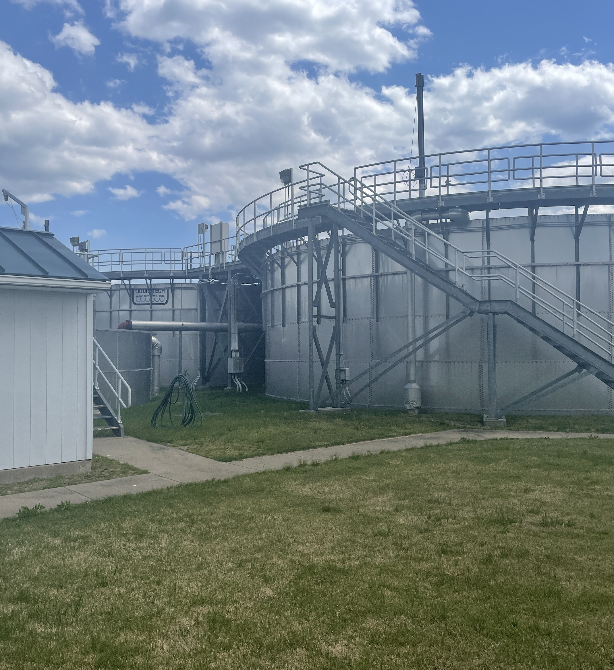
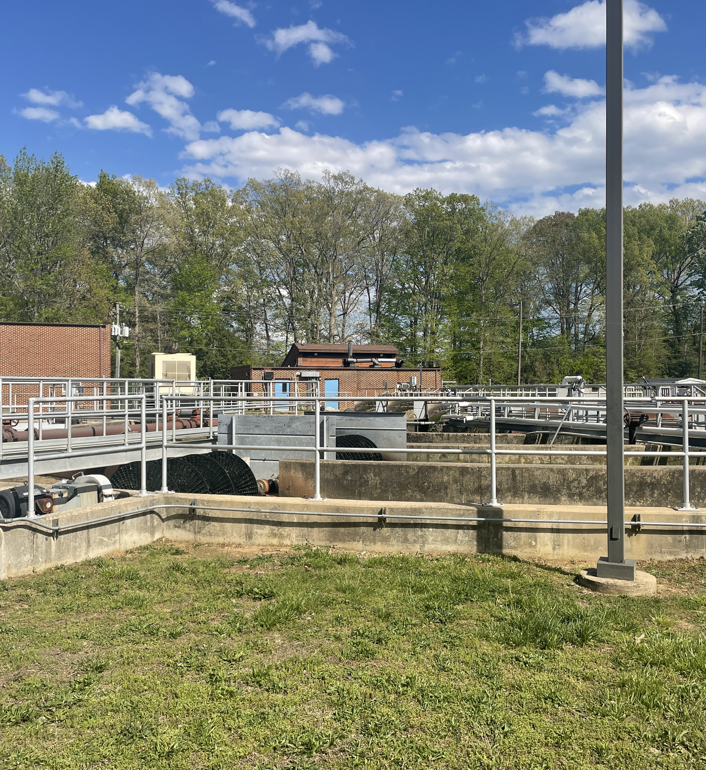

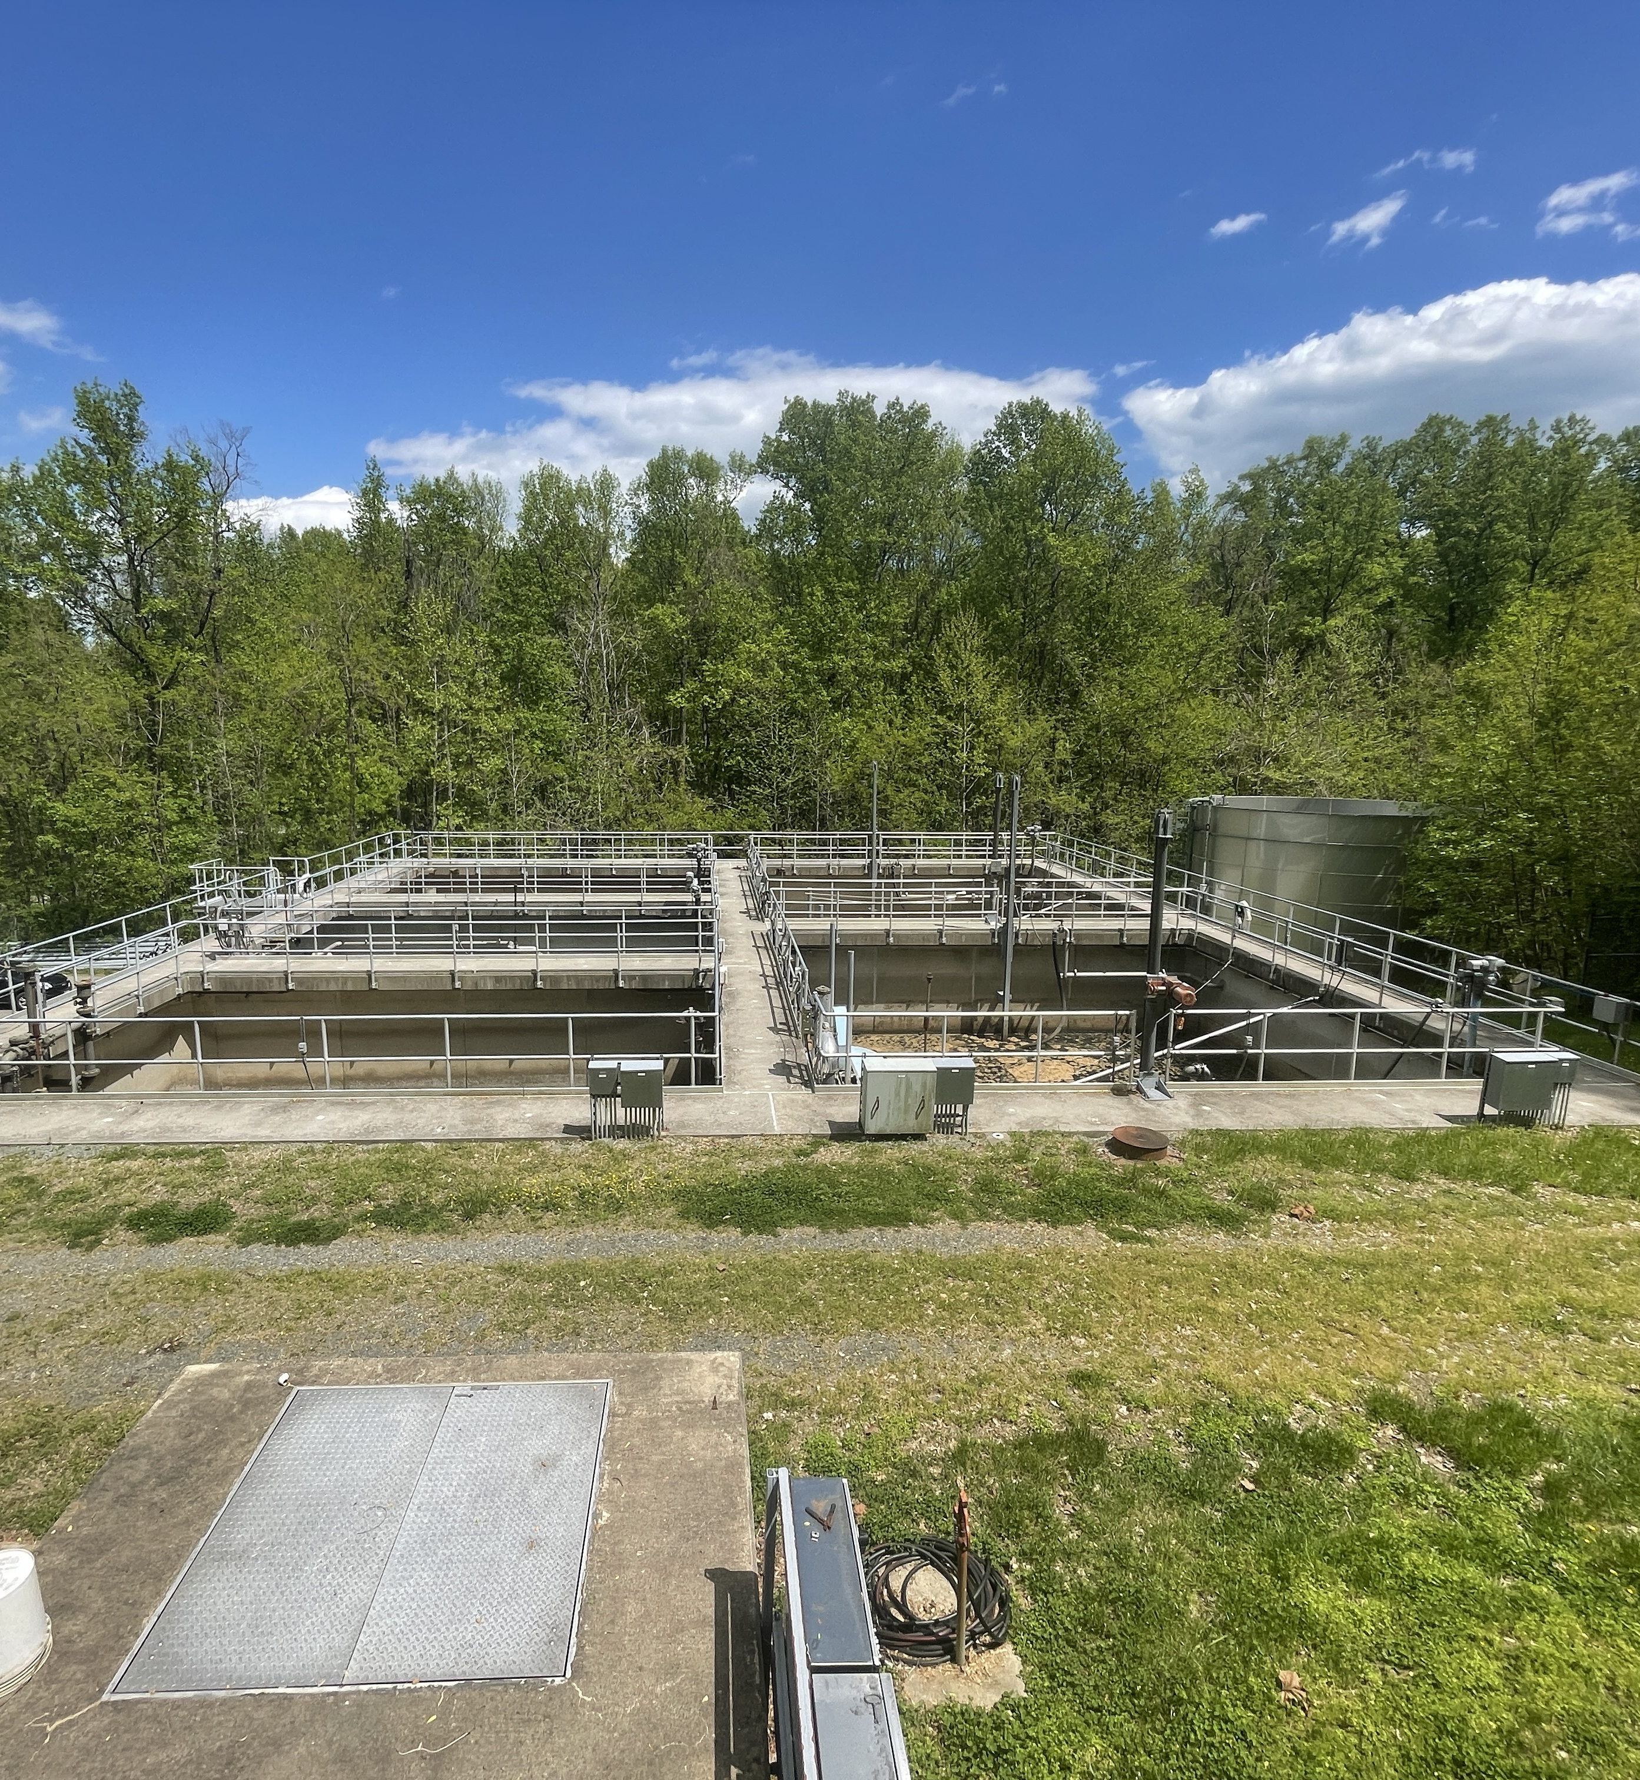

FEBRUARY 2025
Monthly Operations Overview

Slide 2
February Water
Air release valve replaced on Filter #2 (Fairview Beach)
New Cl2 injector installed on raw water line (Canterbury)
Chemical feed pump replaced (Saft Well)
Oakland/Sealston water tower transducer replaced.

Slide 3
February Wastewater
Dahlgren: Conveyor belt replaced on sludge press; delt with freezing issues on water reuse booster pumps; new UV light installation ongoing.
Hopyard: electrical issues of influent auger addressed; SBR blower motor #1 pulled for repair.
Purkins: ACE site visit to review decommission project; permit exceedance for TSS as a result of disc filter being non-effective, site visit has been scheduled with filter manufacture to go over system.
Oakland: crushed chemical feed line replaced; KGCSA contracted welder onsite to weld on tank structures of EQ basin.
Fairview Beach: PM of all blowers; made operational changes to mitigate loading from the pre-EQ.

