Slide 1
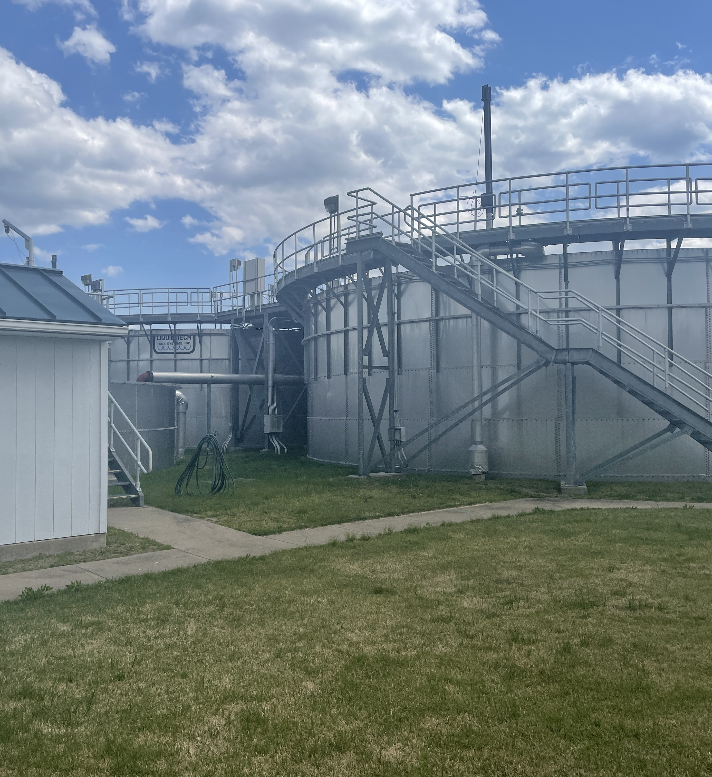
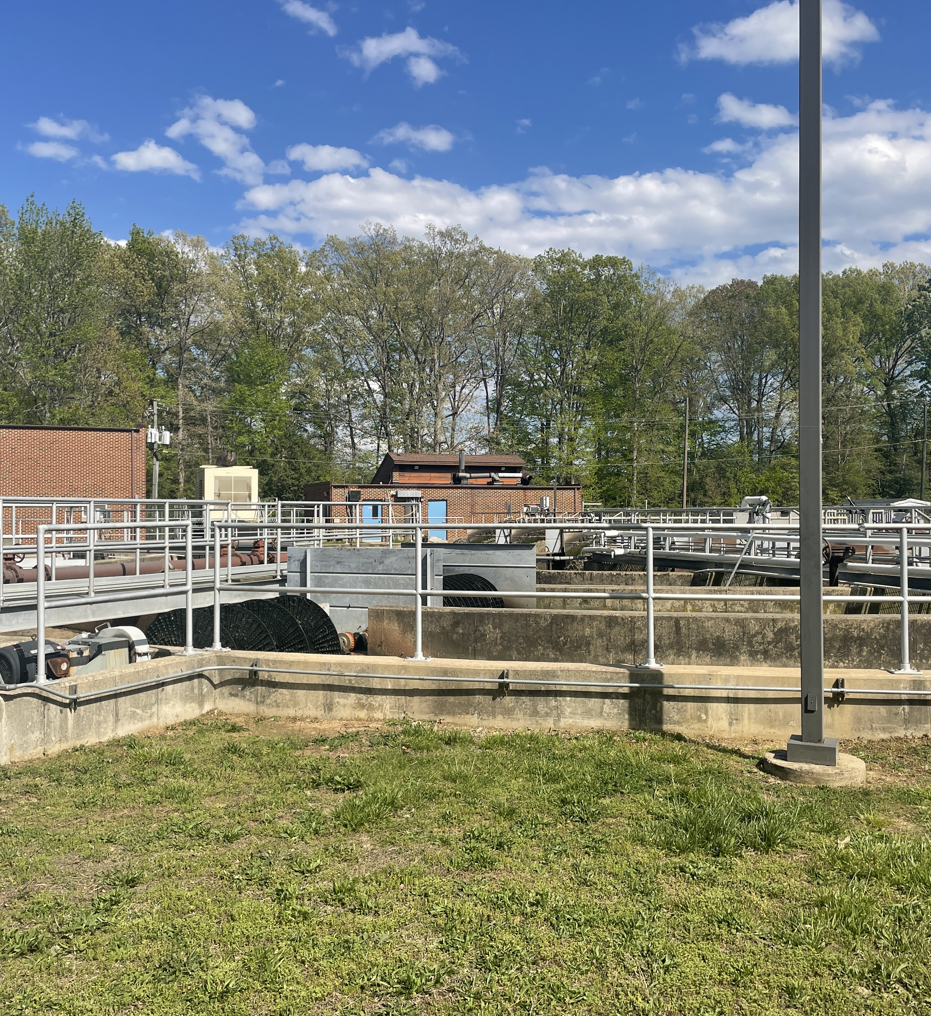

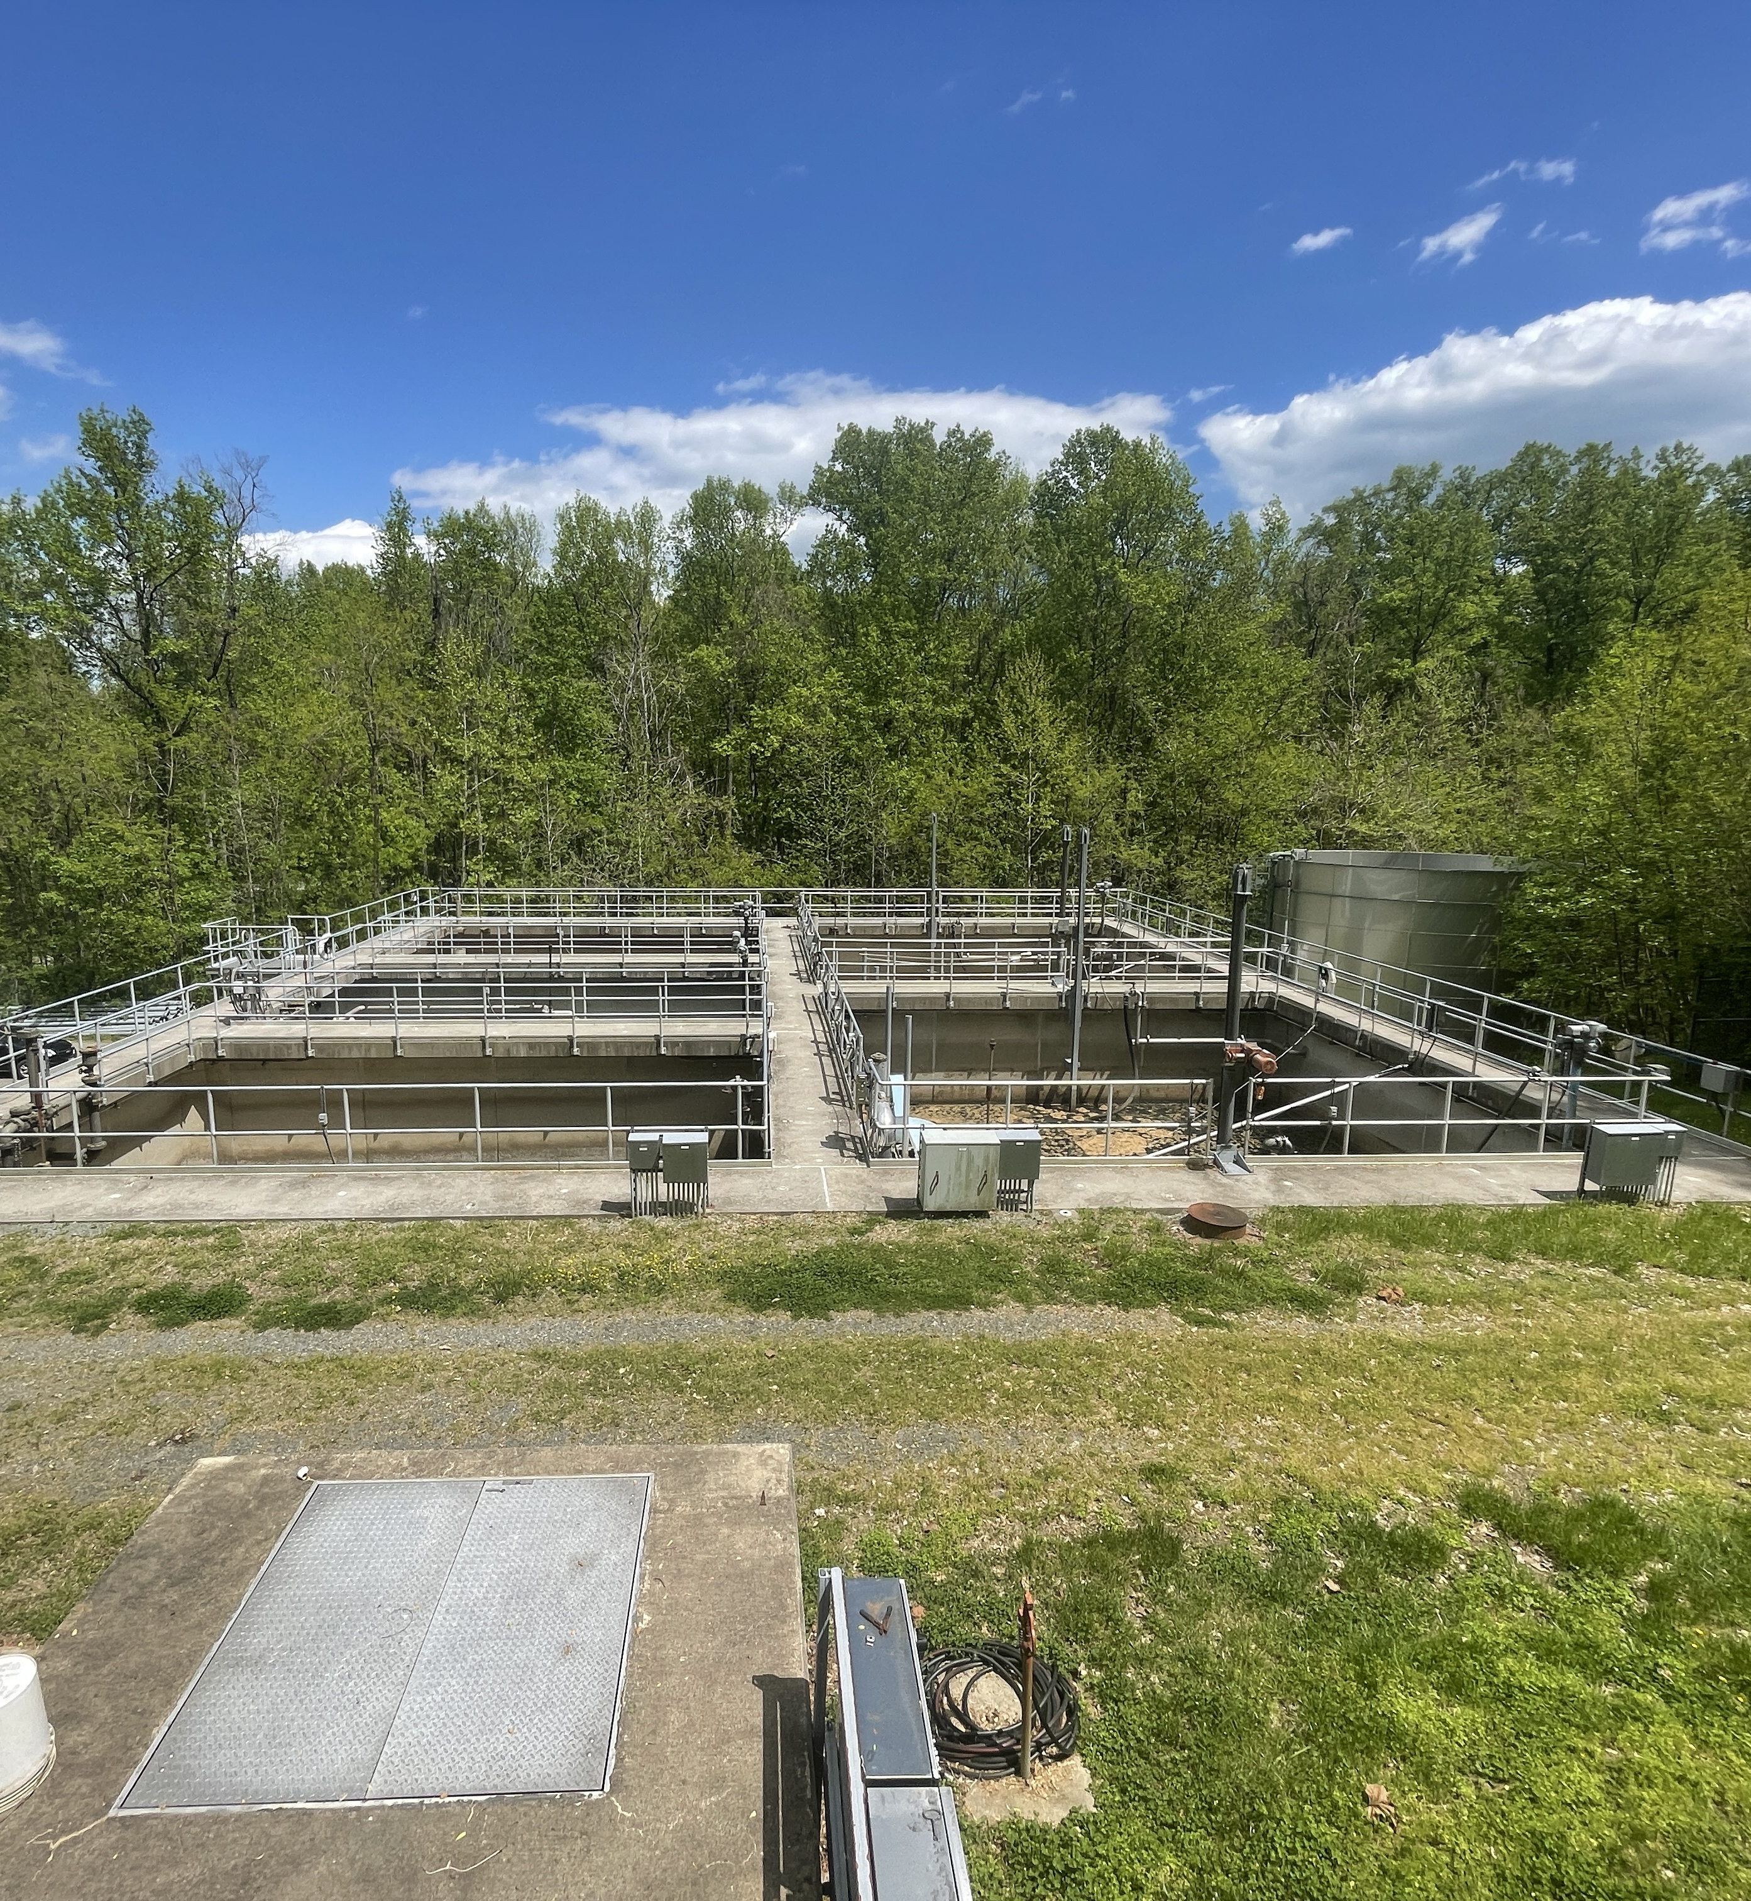

MAY 2025
Monthly Operations Overview

Slide 2
May Water
All regulatory samples and required reports were completed on time.
On June 6th, IES was notified of dirty water complaints in the Claydael water system.
Met on-site with Cathy and Chris to investigate.
The issue was traced to turbidity in the existing well, caused by ongoing drilling of a new well nearby.
KGCSA initiated system flushing to clear sediment and will continue flushing operations until drilling is complete.

Slide 3
May Wastewater
All required samples and reporting were completed for the monitoring period.
Purkins Corner WWTP: Violations occurred for CBOD, TSS, E. Coli, and TKN.
KGCSA has replaced air diffusers in the aeration basin, which is already improving treatment performance.
The UV disinfection system was also rebuilt using repurposed components from the Dahlgren UV upgrade.
Oakland Park WWTP: Violations for CBOD, E. Coli, and TKN.
Continued presence of septic sludge in the influent is disrupting treatment.
KGCSA maintenance is actively addressing the issue within the collection system
Aeration diffusers are scheduled for replacement to restore treatment efficiency.

Slide 4
Questions?

