Slide 1
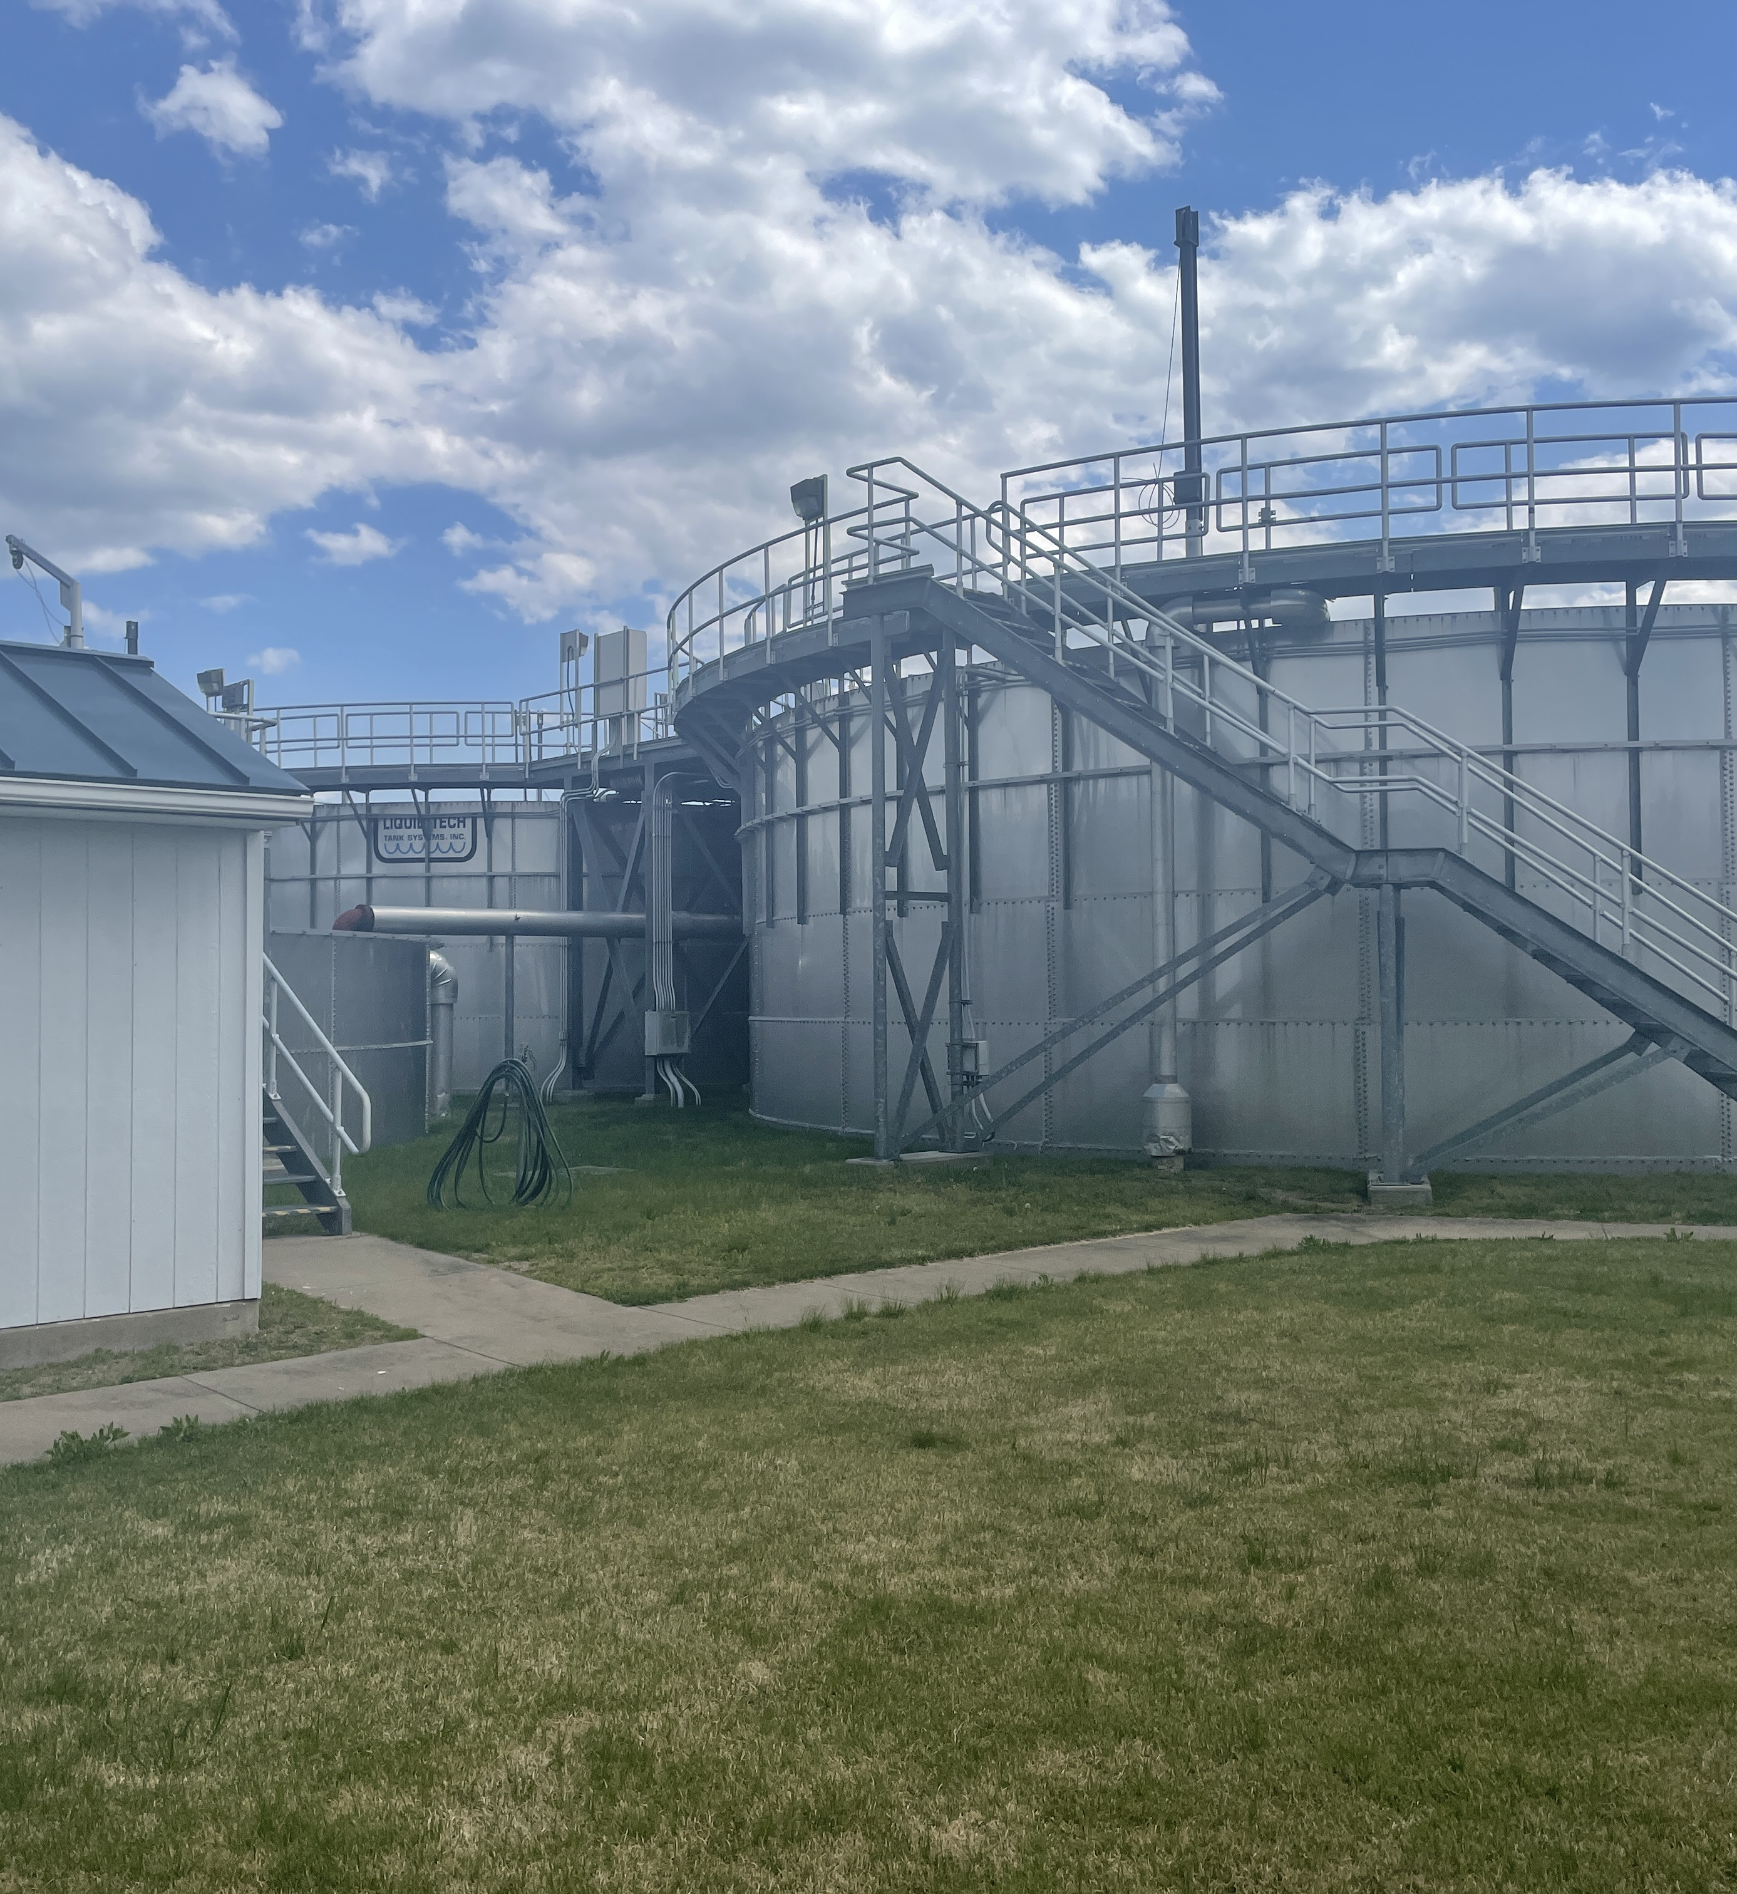
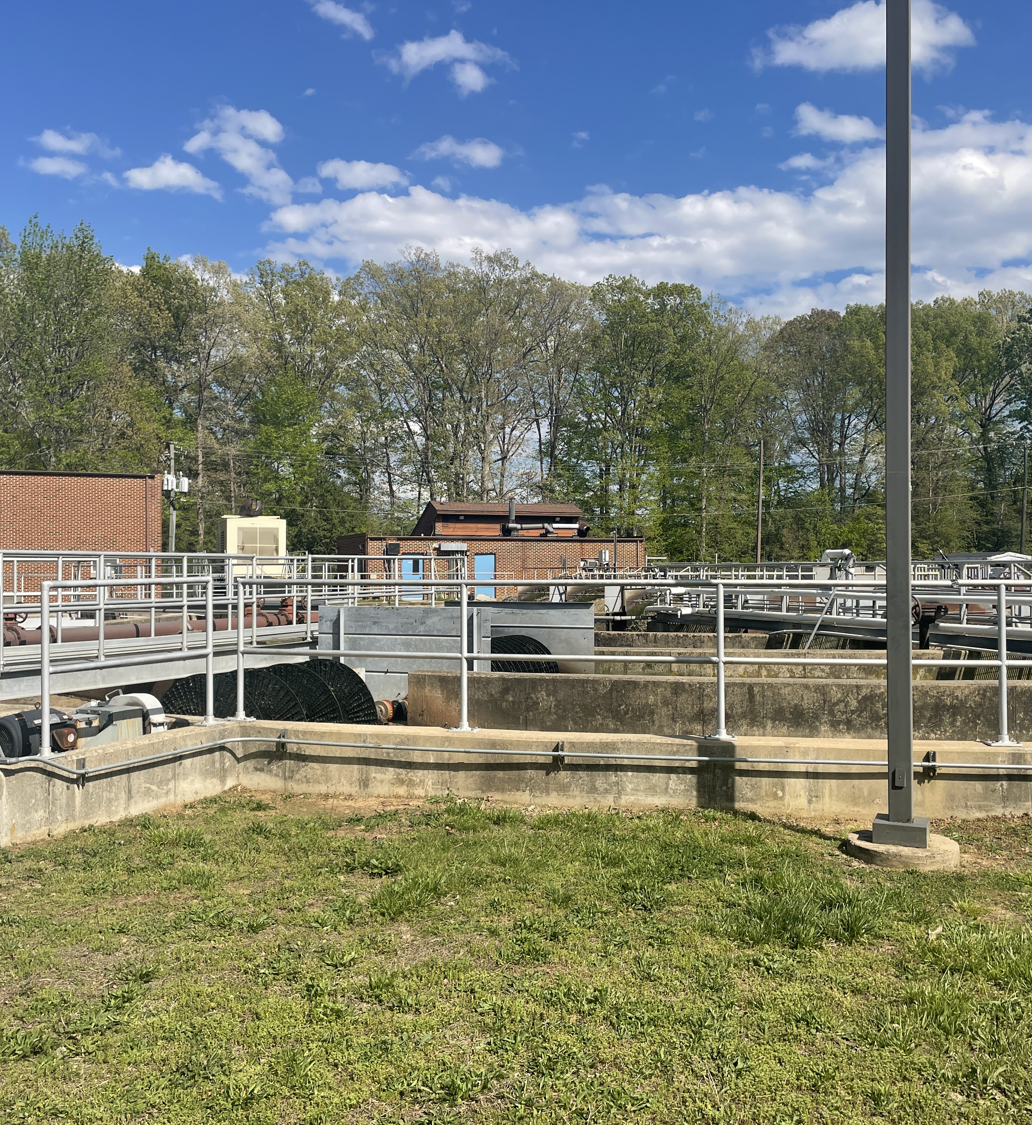

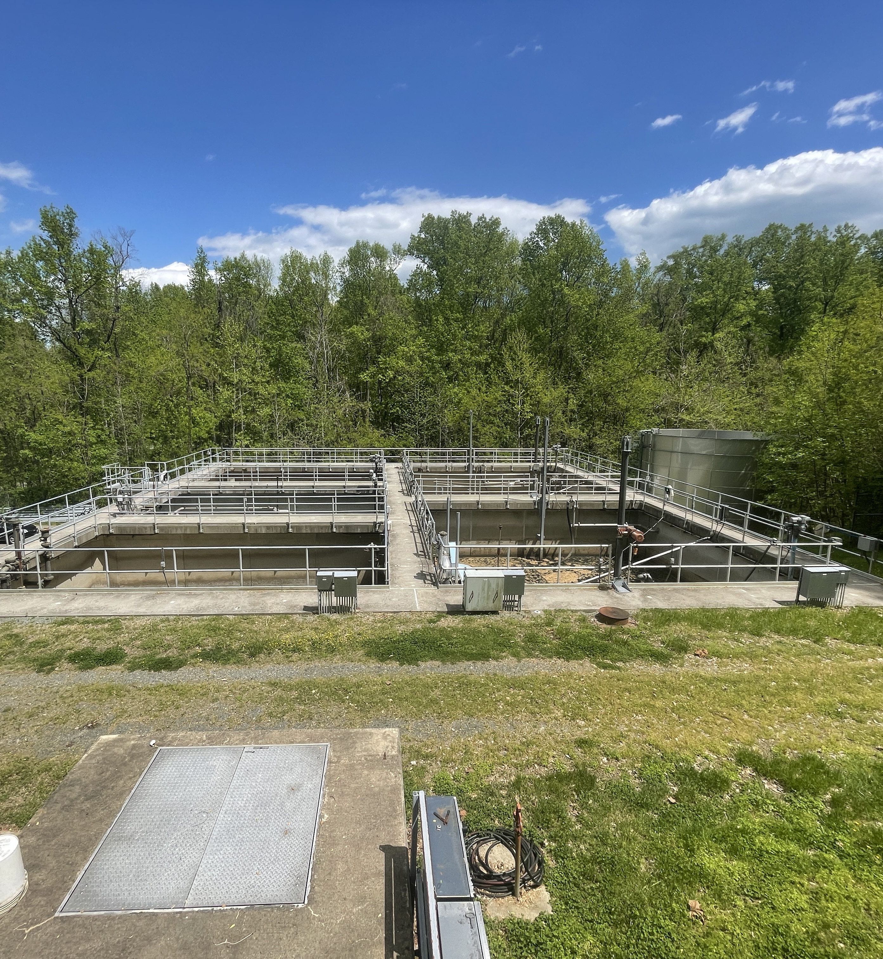

AUGUST 2025
Monthly Operations Overview

Slide 2
September
Hopyard: There was an effluent exceedance for E. coli due to a high sample result collected on August 13th. IES has identified the cause of this high result as the ongoing construction at the WWTP around the UV disinfection system.
Purkins Corner: During this monitoring period, the Purkins Corner WWTP had elevated TSS concentrations of 10.5mg/L and 15.4mg/L, exceeding the monthly and weekly permit limits of 10mg/L and 15mg/L. This was due to the disc filter needing repair.

